Slide 1
caArray User Community Meeting
1.x Update and 2.0 Development Status
Call in: 877-416-5524
Participant Passcode: 2627056
Centra: http://ncicb.centra.com
Meeting ID: array_nov28
November 28, 2007

Slide 2
Agenda
1.6 update
2.0 Update
  Where we are
  What are the expected results
  What we need from the user community

Slide 3
caArray 1.6 – Maintenance release
Targeted as the last release of the 1.x product, scope of 1.6 was expanded to include enhancements for data loading
  Overall memory footprint reduced
  Reduced total processing time
    Ex: Affymetrix cel file loading is ~20% faster per file
  Overall stability improved
Additional fixes described in previous meetings
  A number of issues that have been identified when loading MAGE-ML files that have been created from MAGE-TAB files using the EBI’s Tab2MAGE converter
  Annotation error for existing file in an Experiment
  Performance of adding and updating Sources
  Messaging to user for status of array design parsing
  Sample extract characteristics searches
  Addressed errors in JUnit tests upon MAGE-OM API installation

Slide 4
caArray 1.6 Release Schedule
<Indicate whether production release is available>
<Give timeframes for the update of the download center>

Slide 5
1.x >> 2.0 transition <ultimately move to later in the presentation>
The NCICB production instance of caArray 1.x will be ultimately be converted to read-only
  To avoid two instances where data could be loaded
  Conversion will likely happen after the 2.0 release
1.x will be kept up for at least 6 months – longer if needed by the community
Data from 1.x will be migrated to 2.0
  1.x Experiments URLs will be supported in 2.0 so that external references are maintained
  For local installers of caArray who want to migrate their data, support will be provided by the caArray team

Slide 6
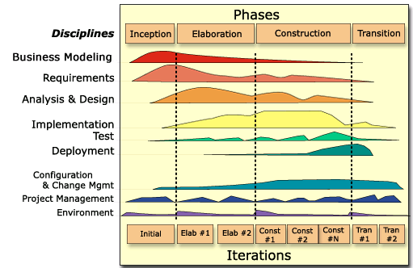
caArray 2.0 - Where We Are
2.0 Construction 2
  Nov 2 Scheduled for Completion
  Domain Object Model Finalized – APIs constructed
  Adding Data Types for round-trip import and extraction
  Finalizing Scope
2.0 Construction Iteration 1
  Completed 10/5
  User Interface Flushed Out
  Fundamental Functionality Created

Slide 7
Results of Construction Iteration 1
Project Management:
  Refined 2.0 Schedule and Scope, Detailed C2 Schedule, and identified release points for 2.0 (Dec 14 targeted for GA deployment)
Requirements:
  Use Cases Reviewed and Revised
  UI Design Reviewed, Revised, HTML Templates Created
Analysis and Design
  Completed Domain Model for Approval
  Held Architectural Reviews with internal and external stakeholders
Implementation
  Converted to Struts2 from JSF for UI, Incorporated CSM 4.0 and contributed Code to CSM team, Adopted caGrid 1.1
  Added to Upload, Validate, Import, Access via API, Login and introduced Manage Permissions Use Cases
Testing
  Performance Testing – plan established

Slide 8
Review of 2.0 Significant Architectural Decisions
Data Storage
  Files stored as blobs;
  Parse-on-demand implemented, initial performance benchmarks established
    Once a file is parsed for its contents by column of interest, that column of data is stored in the database and won’t be parsed again
Grid Service
  Will be anonymous-user only
  Experiments made public (or samples within an experiment made public) will be available over the Grid
Java API Service
  Local Installers will be able to use the Java API to get at their full set of data with the permissions applied (will act in the same way as the UI)
CSM 4.0
  Using it to allow for experiments or samples within experiments to be made public or private following group schemes
  Software Architecture Document
  Domain Model HTML (IE Only)

Slide 9
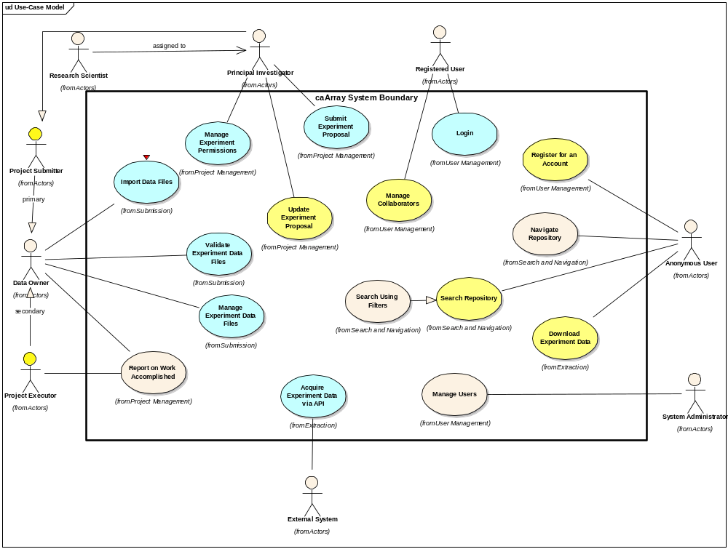
2.0 Use Case Model – What’s In 2.0

Slide 10
Anticipated scope: Supported file formats
Supported (parsable) file formats
  Affymetrix Expression
  Affymetrix SNP
  Illumina Expression
  Illumina SNP
  GenePix
Determining the number of pre-bundled Array Designs within supported formats
  In addition, the ability to import array designs for supported providers is available

Slide 11
Anticipated scope: Data input and export
Data input
  Web portal
    Use of MGED Ontology for annotation
  MAGE-TAB
    Native hyb data associated as Data External
Data export
  Query via the web portal; download native files
    Download selected files for an experiment or the whole experiment
    Download files for selected samples in an experiment
  APIs – both perform the same read-only functions
    Remote Java API
      Provides an alternative remote API to the grid service. Users that are not grid enabled, or otherwise prefer features available in Java (e.g., streaming of data files)
    Grid Service
      Compliant with Grid 1.1
      Standard Data Method (CQL)
      And an Analytic Service

Slide 12
Anticipated scope: API
Support for MAGE-TAB level of annotation
Convenience methods will be provided for retrieval of hyb data
  The Data Service: The data available via the data service is any information stored in caArray 2.0 that does not require inspecting the contents of individual data files. Examples of this type of data are:
    Experiment information such as name and collaborators
    Hybridization information
    File name or type (but not contents)
  The Analytic Service: The analytic service provides access to information stored within files. Examples of this data include:
    Full file contents

Slide 13
Anticipated scope: Permissions and Security
Role-based permissions for each Installation
  Anonymous user
  PI
  Research scientist
  Lab Manager
  Lab Scientist
  Biostatistican
  System Administrator
Most Data is Private until made Public
  Ticklers of information are searchable (title, PI, number of samples) but deep experiment content is not available to the anonymous user
Collaboration groups can be managed by the PI to give pre-public insight
CSM 4.0
  Field level security available but not definable on the UI

Slide 14
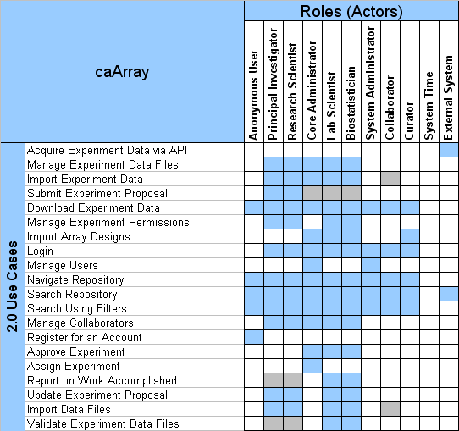
caArray 2.0 Roles to Capabilities Matrix
Notes:
all data owners can manage experiment files
if given permission to do so on a particular experiment or samples within an experiment
lab personnel may want to create their own experiments but would be treated as a PI
public data = everyone, private data is restricted based on experiment/sample permission
ext. system uses the API, not the UI
dependent on experiment type - (full, partial, analysis), PI/RS may need to execute this

Slide 15
Anticipated scope: Browse and search
Browse by
  Experiments
  Organism
  Provider
  Array design
Search by specifying
  Keyword
  Category
Results are returned organized by Experiment, with the associated Samples

Slide 16
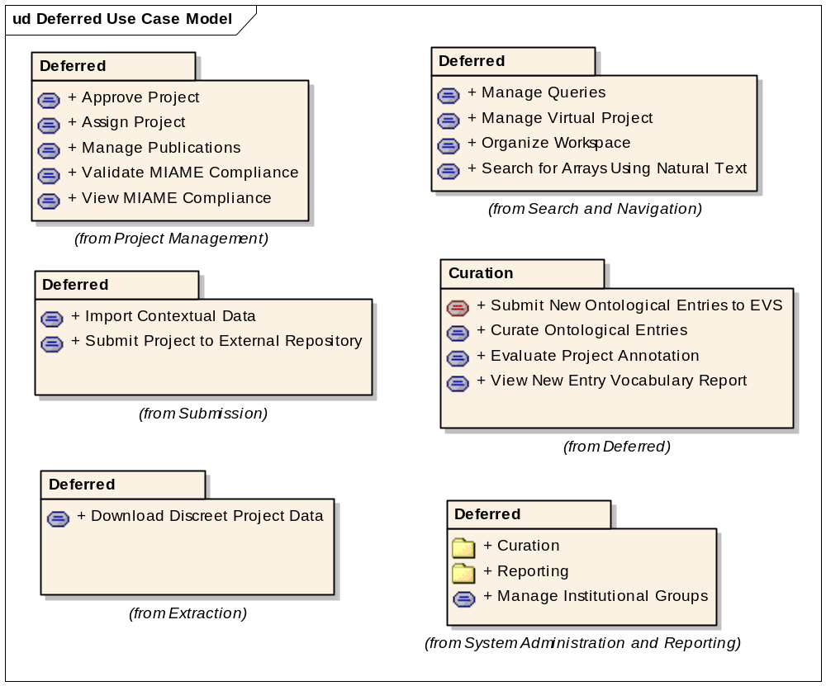
What’s been deferred

Slide 17
Additional Points of Deferral
The Search Using Filters is likely to be deferred
Workflow is a Major Feature Trimmed
  While some aspects will be available, the following will not be:
  Submit an experiment to a particular lab (Submit Experiment Proposal)
  Management of multiple labs inside an institution (Manage Institutional Groups)
  Creating highly tailored workflow to the lab end of the workflow (Report on Work Accomplished)
  Once the Scope is finalized, the GForge Use Case Tracker will be updated with what flows will be available in the UI

Slide 18
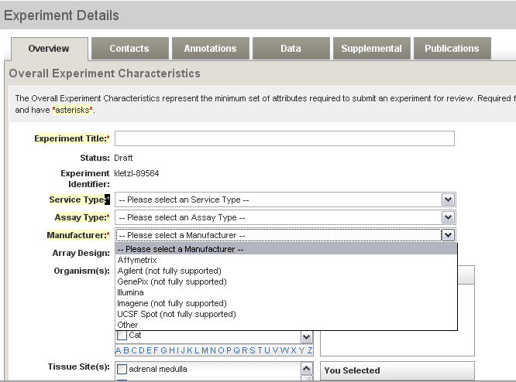
Questions we have for you – Data Providers
Providers and Data Upload
  Should caArray restrict the ability to upload data to only those Providers we anticipate having parsers for (Affymetrix, Illumina, GenePix)?
  If you think we should not restrict that ability, users will have the ability to download data from an Agilent Experiment but not be able to retrieve its file contents through the API

Slide 19
Questions Continued: Controlled Vocabulary
Controlled Vocabulary without Curation
  Should caArray allow for user defined criteria to be entered where no CV values exist in the NCI Thesaurus or the MGED Ontology?
  Should those values entered be available to anyone who is a part of the installation or restricted, perhaps by the user's organizational affiliation?
  If we allow for controlled vocabulary values to be entered, should we enforce/requiring entering descriptions of where the term can be found so we can add validation/verification later or simply allow for a curator role to be created to support cleaning up of values?

Slide 20
Continuing Engagement Model
Continue Monthly Meetings
G-Forge site for 2.0 is available that indicates needs, features, use cases and test cases
  We will continue to publish regularly and investigate forums and surveys for targeted feedback
G-forge site: https://gforge.nci.nih.gov/projects/caarray2/

Slide 21
Next Steps
Please visit G-Forge: https://gforge.nci.nih.gov/projects/caarray2/ to view the prioritization of features, use cases (Tracker items), links to critical documents (Docs Tab)
Results of Construction Iteration 2 November 2nd, 2007
Next meeting date: TBA but anticipated November 14, 2007

